Slide 1

ALGORITHMIC TRADING
CMR COLLEGE OF ENGINEERING & TECHNOLOGY
Kandlakoya, Medchal, Hyderabad - 501401
Department of Computer Science and Engineering
BATCH NO. 62
L Bharadwaj 18H51A0517
M M Prathyush 18H51A0518
G Vineetkumar 18H51A0596
Under esteemed guidance of
Dr. Sarat Chandra Nayak

Slide 2

CMR COLLEGE OF ENGINEERING & TECHNOLOGY
Kandlakoya, Medchal, Hyderabad - 501401
Department of Computer Science and Engineering
ALGORITHMIC TRADING
BATCH NO. 62
L Bharadwaj 18H51A0517
M M Prathyush 18H51A0518
G Vineetkumar 18H51A0596
Under esteemed guidance of
Dr. Sarat Chandra Nayak

Slide 3
ABSTRACT
Stock market is like a probabilistic trading where we can gain and have possibility of loss. Investing in stock market trading might be a risky task.
Algorithmic trading can be used that works on the previous trends of a particular stock and help us predicting the stock market.
Algorithmic trading use machine learning techniques to increase the probability of profit because it uses the technical analysis of stock, price action strategies, seasonal trends and help us to predict which time is better to invest in stocks.
We are developing an algorithm using machine learning and deep learning techniques such as RNN(Recurrent Neural Network) and LSTM for algorithmic trading.

Slide 4
PROBLEM UNDERSTANDING
MOTIVATION OF STUDY
OBJECTIVES
PROBLEM STATEMENT, SCOPE & LIMITATIONS

Slide 5
MOTIVATION OF STUDY
Now a day’s, the prediction of stock market prices has become a major research topic
The behavior of stock market is very nonlinear and volatile in nature.
So Investing has become a risky task for the people.
But it is not at all a risky task to machine that uses machine learning techniques.
Infact the predictions will be very close to real time data

Slide 6

OBJECTIVE
To design efficient system for predicting the stock market movement using ML .
Specifically, use LSTM method to Predict stock price based on the historical data.
Compare existing methods to show the superiority of LSTM.

Slide 7

PROBLEM STATEMENT
Stock market is just like a probabilistic trading where we can gain and have possibility of loss. Investing in stock market trading might be a risky task. So, we can use algorithmic trading which uses the previous trends of a particular stock and help us predicting investing in the stock that gives us more profit.
P/E * EPS = PRICE
If we can predict stocks future P/E and EPS, We will know accurate PRICE

Slide 8
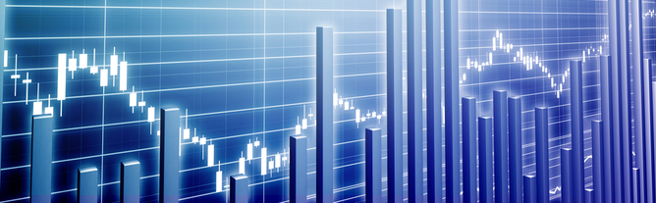
SCOPE & LIMITATIONS
We predict the stock market upto one month.
It is hard to predict in the pandemic sitations

Slide 9
LITERATURE SURVEY

Slide 10
MOVING AVERAGE
Simple moving averages calculate the average of a range of prices by the number of periods within that range.
A simple moving average is a technical indicator that can help in determining if price will continue or if it will reverse a trend.
A simple moving average can be enhanced as an exponential moving average (EMA) that is more heavily weighted on recent price action.

Slide 11
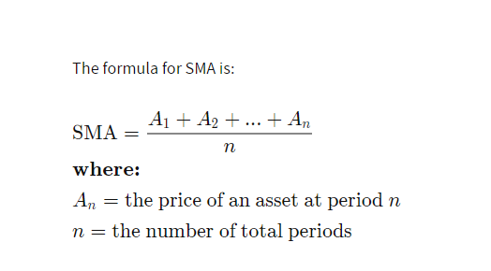

Slide 12

Statistical
Auto-Regressive Integrated Moving Average
(ARIMA)
ARIMA models are known to be robust and efficient in financial time series forecasting
It constantly outperformed complex structural models in short-term prediction
But they work only for a particular time series data
It is categorized into linear that is it cannot handle nonlinear behavior of stock market

Slide 13
Terminology
Model parameters
AR: Auto Regressive
It is the dependent relationship between
an observation and predefined number of lagged observations
I: Integrated
means the differencing of raw observations
MA: Moving Average
The relationship between the residual error and the observations.
p is the number of lag observations.
d is the degree of differencing.
q is the size/width of the moving average window.

Slide 14

RNN (Recurrent Neural Network)
RNN is a class of advanced artificial neural network (ANN)
It is categorized into nonlinear
RNN takes input from two sources, one is from the present and the other from the past
Information from these two sources are used to decide how they react to the new set of data
But fails in forecasting long term duration

Slide 15

Fig: RNN
In a feed-forward neural network, the information only moves in one direction from the input layer, through the hidden layers, to the output layer.
The information moves straight through the network and never touches a node twice. Feed-forward neural networks have no memory of the input they receive and are bad at predicting what’s coming next.
RNN the information cycles through a loop. When it decide, it considers the current input and what it has learned from the inputs it received previously.

Slide 16
IMPLEMENTATION OF EXISTING MODELS

Slide 17
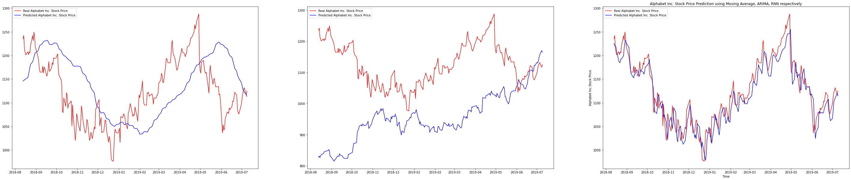
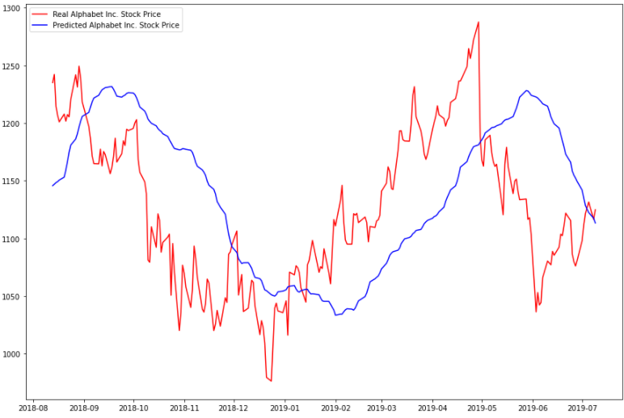
Google stock
SIMPLE MOVING AVERAGE ARIMA RNN
Fig: SMA Prediction

Slide 18
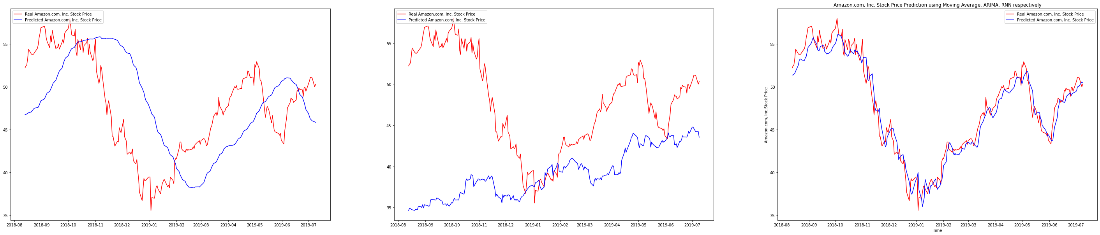
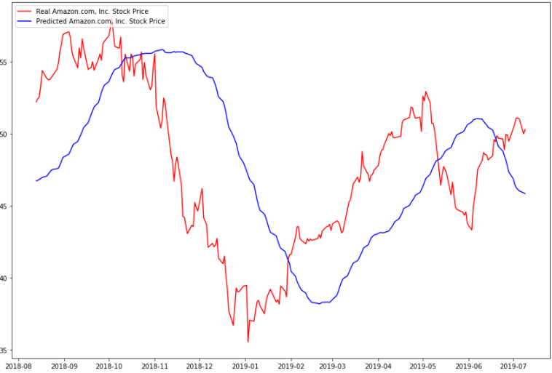
Amazon stock
SIMPLE MOVING AVERAGE ARIMA RNN
Fig: SMA Prediction

Slide 19
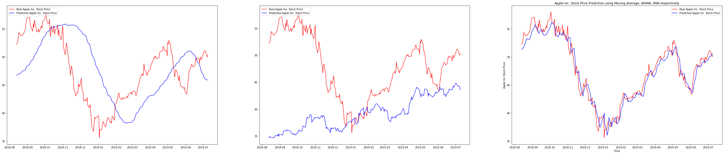
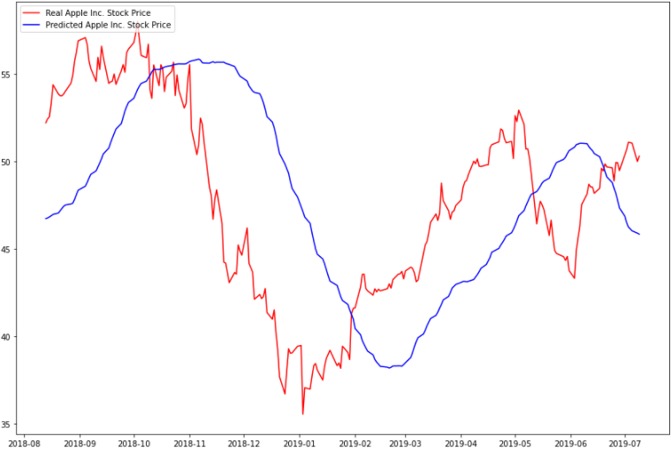
APPLE stock
SIMPLE MOVING AVERAGE ARIMA RNN
Fig: SMA Prediction

Slide 20
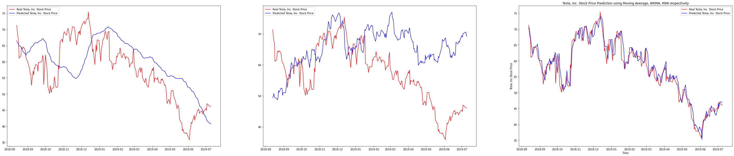
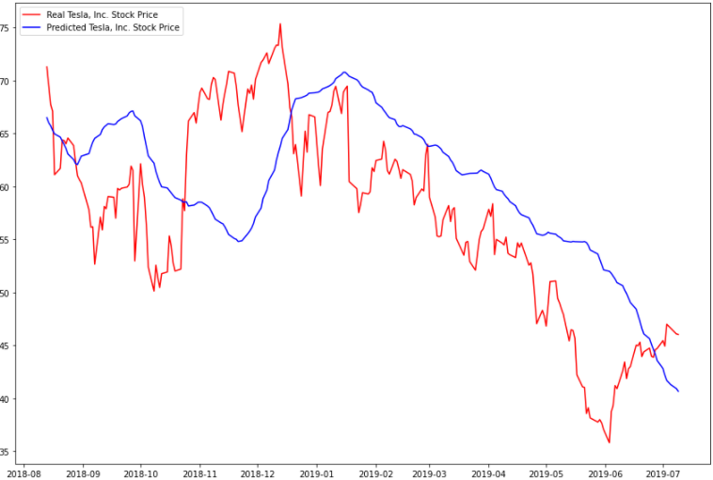
TESLA stock
SIMPLE MOVING AVERAGE ARIMA RNN
Fig: SMA Prediction

Slide 21
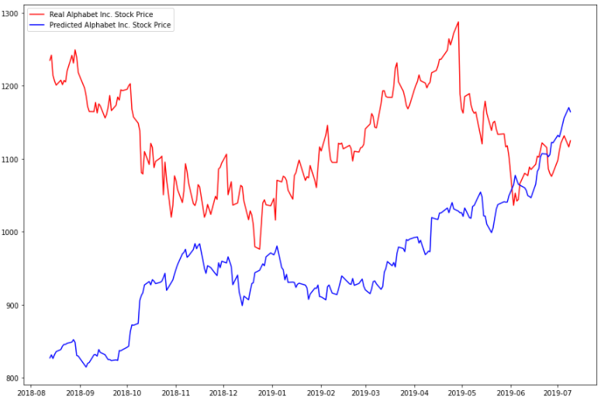
Google stock
SIMPLE MOVING AVERAGE ARIMA RNN
Fig: ARIMA Prediction

Slide 22
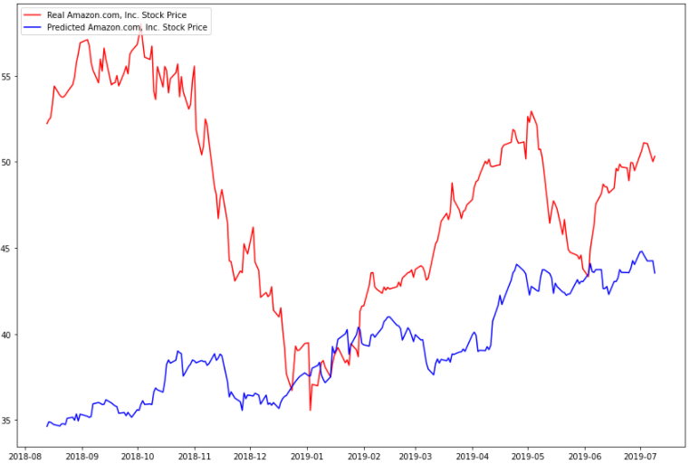
Amazon stock
SIMPLE MOVING AVERAGE ARIMA RNN
Fig: ARIMA Prediction

Slide 23
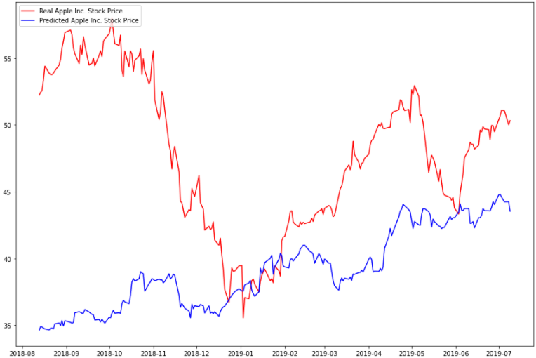
APPLE stock
SIMPLE MOVING AVERAGE ARIMA RNN
Fig: ARIMA Prediction

Slide 24
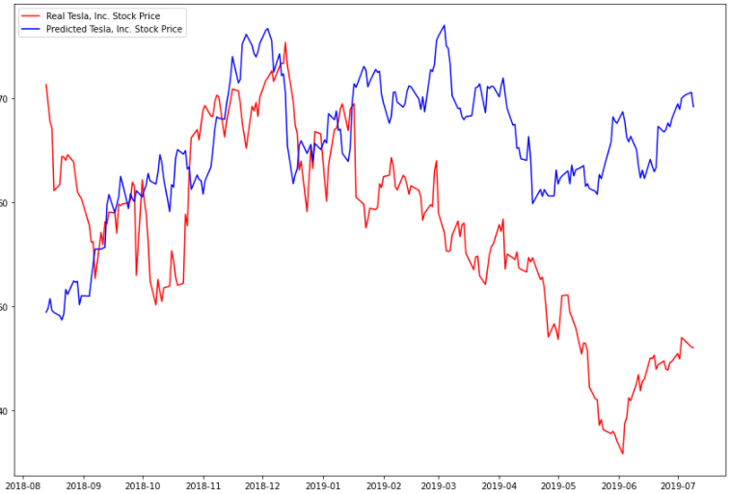
TESLA stock
SIMPLE MOVING AVERAGE ARIMA RNN
Fig: ARIMA Prediction

Slide 25
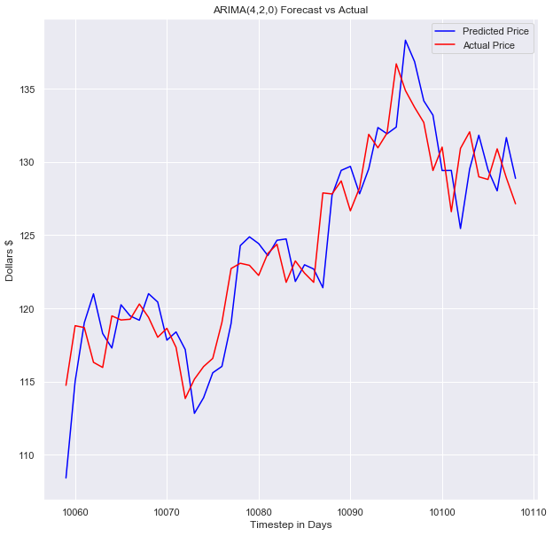
ARIMA 1Day prediction

Slide 26
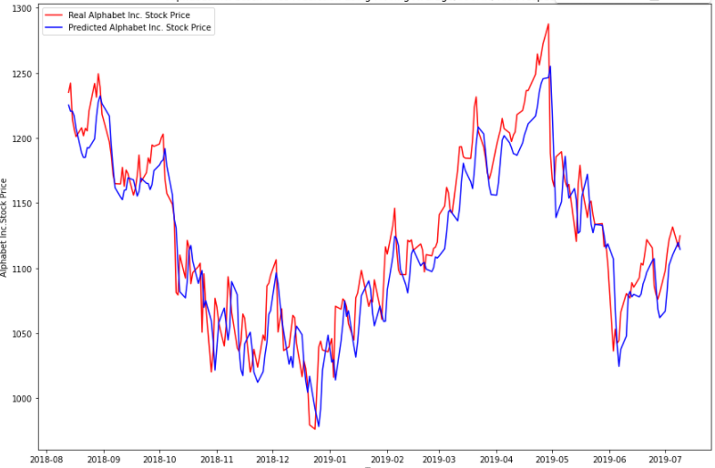
Google stock
SIMPLE MOVING AVERAGE ARIMA RNN
Fig: RNN Prediction

Slide 27
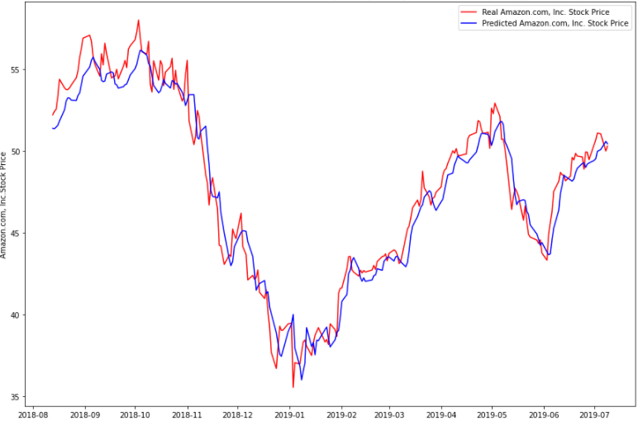
Amazon stock
SIMPLE MOVING AVERAGE ARIMA RNN
Fig: RNN Prediction

Slide 28
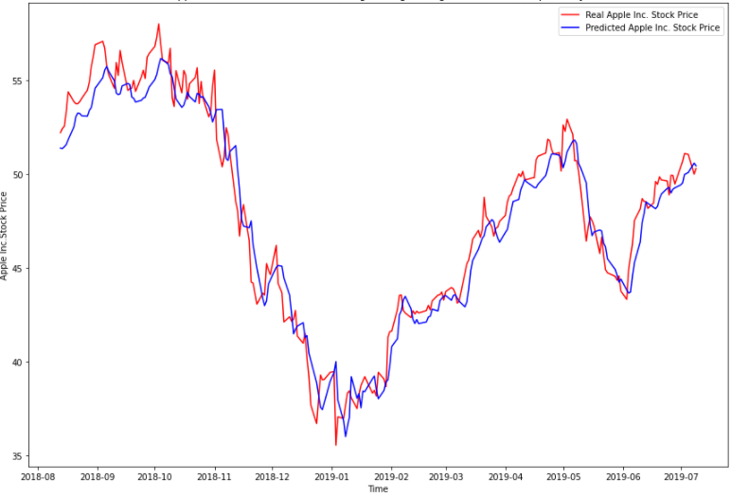
APPLE stock
SIMPLE MOVING AVERAGE ARIMA RNN
Fig: RNN Prediction

Slide 29
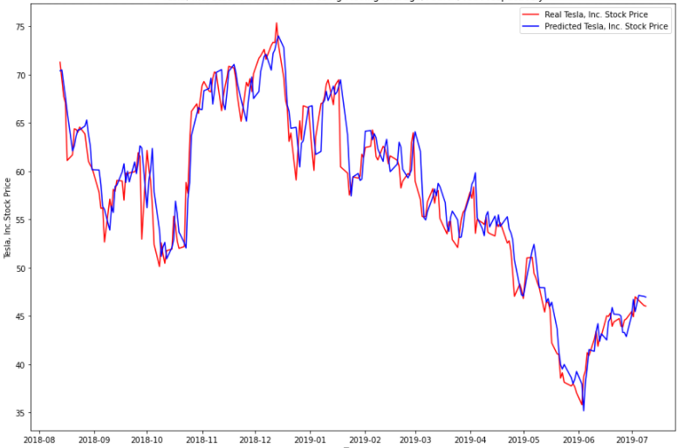
TESLA stock
SIMPLE MOVING AVERAGE ARIMA RNN
Fig: RNN Prediction

Slide 30
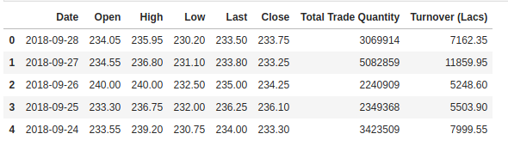
DATA SET COLLECTION
NSE (National Stock Exchange of India)
BSE (Bombay Stock Exchange)
NYSE (New York Stock Exchange)
Money Control
Google Stock Prices
Yahoo
China’s Shanghai and Shenzhen stock markets
Fig: Sample data set

Slide 31
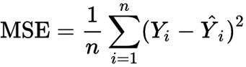
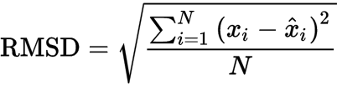
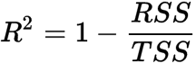
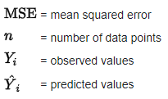
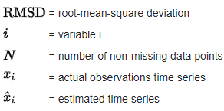
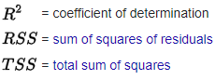
PERFORMANCE METRICS
MODEL | MSE | RMSE | R2_SCORE
Simple Moving average | 5668.585465423127 | 75.2900090677583 | -0.31223237668214043
Arima | 42071.70516132826 | 205.1138833948796 | -8.739264582261903
RNN | 608.6947111664791 | 24.671739119212475 | 0.8590920235074526
Lower (MSE) is the best
Lower (RMSE) is the best
Higher (R2SCORE) is the best

Slide 32
PROCESS
start
Identify problem
Literature survey
Objective
Data set
Design
Implementation
Results
Conclusion
end

Slide 33

REFERENCES
https://towardsdatascience.com/time-series-forecasting-predicting-stock-prices-using-an-arima-model-2e3b3080bd70
https://github.com/0xpranjal/Stock-Prediction-using-different-models/blob/main/Notebooks/4.%20RNN_seqtovec_seqtoseq.ipynb
https://github.com/0xpranjal/Stock-Prediction-using-different-models/blob/main/Notebooks/1.%20Time%20Series%20Forecasting%20with%20Naive%2C%20Moving%20Averages%2C%20and%20ARIMA.ipynb

Slide 34
THANK YOU
ALL
OUR GUIDE
TEAM

Slide 35

LSTM Long-Short-Term Memory
LSTM is an advanced type of RNN
LSTM is proficient in learning about long-term dependencies.
LSTM is popularly used on time-series data for classification, processing, and making predictions.

Slide 36


STRUCTURE OF LSTM

Slide 37
STRUCTURE OF LSTM
Long Short Term Memory Network is an advanced RNN, a sequential network, that allows information to persist. It is capable of handling the vanishing gradient problem faced by RNN. A recurrent neural network is also known as RNN is used for persistent memory.
The first part chooses whether the information coming from the previous timestamp is to be remembered or is irrelevant and can be forgotten. In the second part, the cell tries to learn new information from the input to this cell. At last, in the third part, the cell passes the updated information from the current timestamp to the next timestamp. These three parts of an LSTM cell are known as gates. The first part is called Forget gate, the second part is known as the Input gate and the last one is the Output gate.

Slide 38
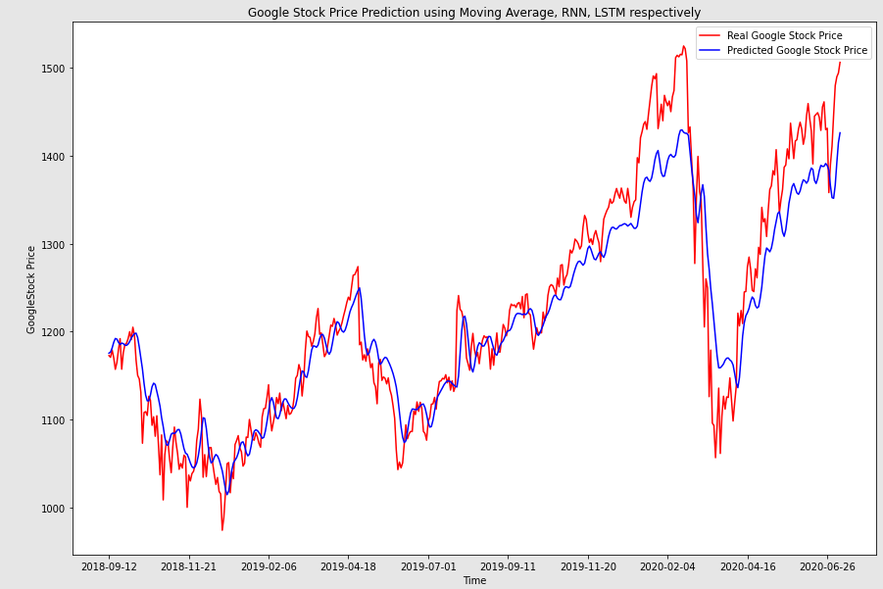
LSTM
Predicting Stock Price with LSTM
We choosen it because its prediction is very close to real values.
It is widely used for sequence prediction and have proven to be extremely effective.
LSTM can store past important information and forget the useless information.
FIG: LSTM SAMPLE RESULT

Slide 39
PROCESS
start
Identify problem
Literature survey
Objective
Data set
Design
Implementation
Results
Conclusion
end

Slide 40
REFERENCES
https://www.ijert.org/research/future-stock-price-prediction-using-recurrent-neural-network-lstm-and-machine-learning-IJERTCONV9IS05065.pdf
https://www.researchgate.net/publication/331385031_Predicting_Prices_of_Stock_Market_using_Gated_Recurrent_Units_GRUs_Neural_Networks

Slide 41
THANK YOU
ALL
OUR GUIDE
TEAM

